Slide 1
Report Launcher Introduction

Slide 2
For further question or troubleshooting, email support@1010data.com
What is the Report Launcher?
The Launcher is the default landing page when you login into 1010data
The Launcher addresses top customer concerns around navigation, usability, and platform speed
The new interface is clean and modern, allowing quicker navigation to applications and reports
What are the Key Benefits of the Launcher?
Quicker load times
One-click to open and run a saved report, directly from the Launcher homepage
Reduced steps in reporting workflows increasing efficiencies
Reports on the data availability of the key data tables you use every day
Search bar and sort functionality allow you to quickly locate a specific saved report
Color-coded “Cards” easily identify saved reports by category (Sales, Category Management, etc.)
© 2022 1010data Services LLC | All Rights Reserved.

Slide 3
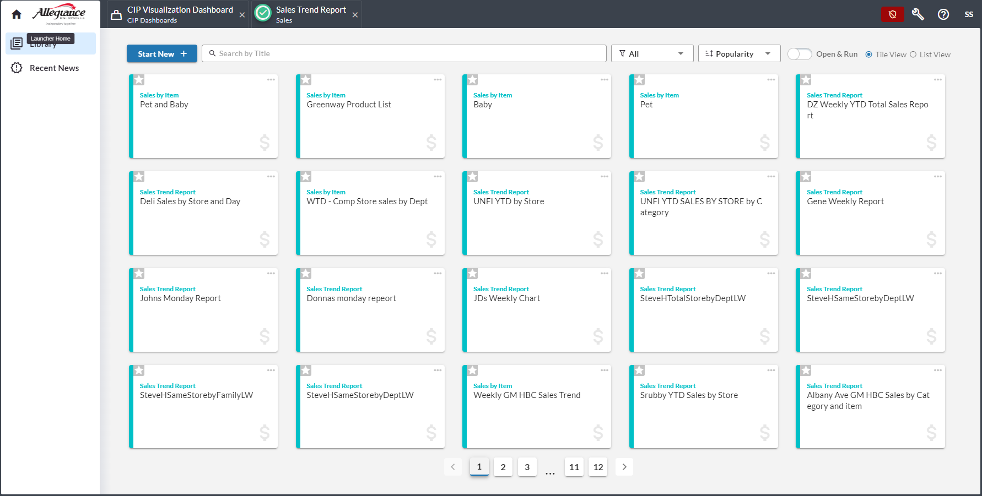
Using the Launcher – Launcher Elements
Data Status Indicator
Report Filter
Create a New CIP Report
Report Sort
Dashboard
Open/ Open+ Run Toggle
Search Bar – Searches Saved Reports
Saved Report Cards – Color-coded by Module
© 2022 1010data Services LLC | All Rights Reserved.

Slide 4
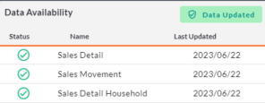
For further question or troubleshooting, email support@1010data.com
Checking Data Status
Quickly indicates if data in key tables is updated
Status Indicators:
  Data Status Updated (Green)– All tables received an updated data feed on the expected date. Table contains latest expected date of data.
    Note data may not be fully loaded or audited. For exact status of a data table, please contact support@1010data.com
  Data Status Impacted (Red)– Data either not received on expected date, or received data not available for latest expected date
Click the “Data Status” Indicator button to view details
  The “Last Updated” column shows the date each table was most recently refreshed
Click the Status Indicator again to hide
© 2022 1010data Services LLC | All Rights Reserved.

Slide 5
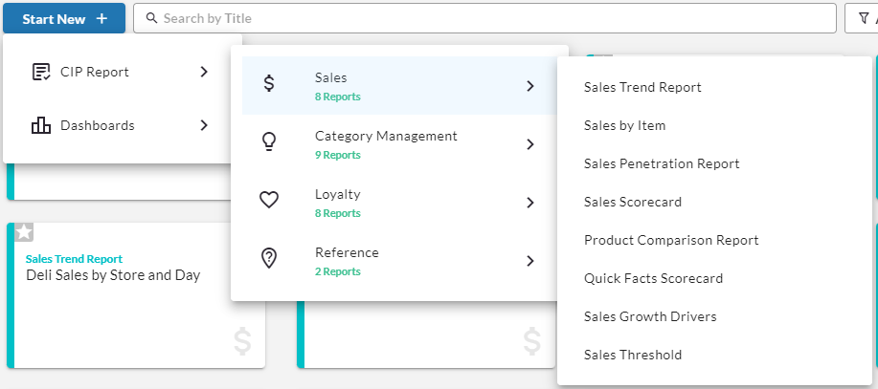
For further question or troubleshooting, email support@1010data.com
Using the Launcher – Creating a New CIP Report
Use the Start New drop-down to open a new CIP report template
Select the type of report:
  CIP Report includes Sales, Category Mana
  CIP Dashboards
How to access CIP Reports: Start New→ CIP Report→ Choose Category
How to access CIP Dashboards: Start New→ Custom App
© 2022 1010data Services LLC | All Rights Reserved.

Slide 6
Saved Report Launcher & Additional Tools

Slide 7
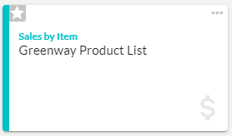
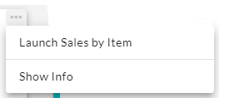
For further question or troubleshooting, email support@1010data.com
Saved Report Cards
Saved Reports created by or shared with you are available as “cards,” quickly launched from the Launcher
Name of the CIP Report used as a basis to create the Saved Report
Favorite Indicator and Drop-Down to Launch CIP Report or Show Info
Name given to the Saved Report by the User who authored and saved the report
Name given to the Saved Report by the User who authored and saved the report
© 2022 1010data Services LLC | All Rights Reserved.

Slide 8
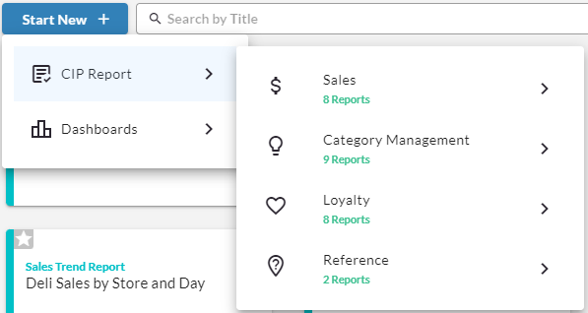
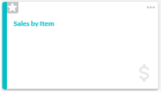
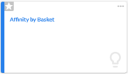
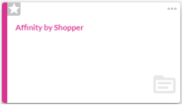
For further question or troubleshooting, email support@1010data.com
Saved Report Cards
Saved Reports are Color-Coded Based on the Report Type Used
© 2022 1010data Services LLC | All Rights Reserved.

Slide 9
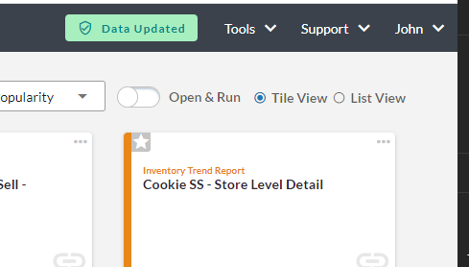
For further question or troubleshooting, email support@1010data.com
Launching A Saved Report
Use the Open / Open + Run toggle to indicate how saved reports should open:
  Open:
    Opens the report in a separate window
    Previous selections are intact but can be modified
    User will select Analyze to run the report
  Open + Run:
    Opens report in a separate window
    Automatically runs the report with all previous selections
    Modifications are made after the report has completed
Edits made to saved reports will not overwrite existing saved reports
Only the author of a saved report can overwrite it

Slide 10
CIP Dashboard

Slide 11
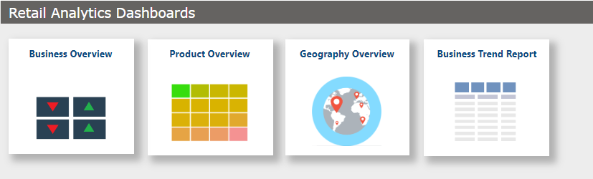
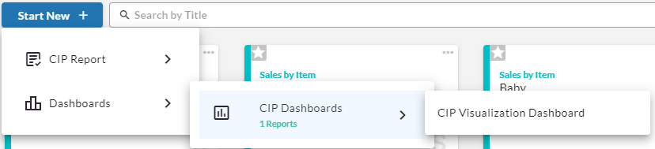
For further question or troubleshooting, email support@1010data.com
Logging In
1. Login to the 1010data platform with your regular 1010data ID
2. On the launcher in the new tab, select “Start New” to access the Landing Page

Slide 12
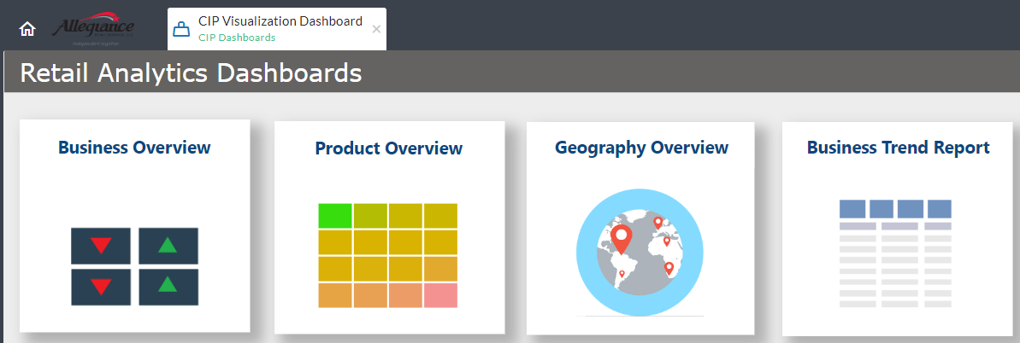
The landing page includes the navigation pane for the 4 dashboards. Click on a pane to launch a dashboard
For further question or troubleshooting, email support@1010data.com
Landing Page and Dashboard Navigation
Business Overview:
  Snapshot of overall company performance across key retail metrics.
  View data by geographic region, and product category.
Product Overview
  Understand performance of different product categories
Geography Overview
  Understand performance of different geographic regions (State) and what product lines are the key drivers in a region
Business Trend Report
  Understand the trend over time of different retail metrics.
1
1
2
3
4
2
3
4

Slide 13
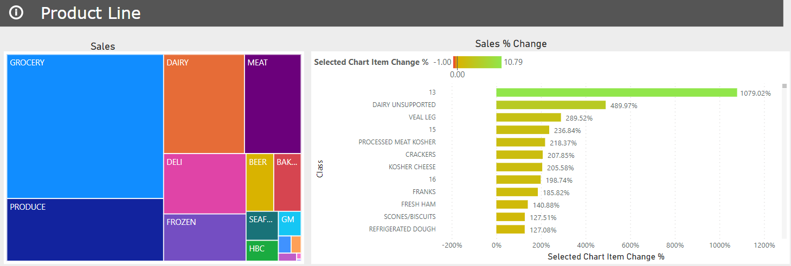
Selecting the (i) icon for the Product line will redirect the user to the Product Overview and allow drilling down the product hierarchy
For further question or troubleshooting, email support@1010data.com
Business Overview - Product Line Subsection

Slide 14
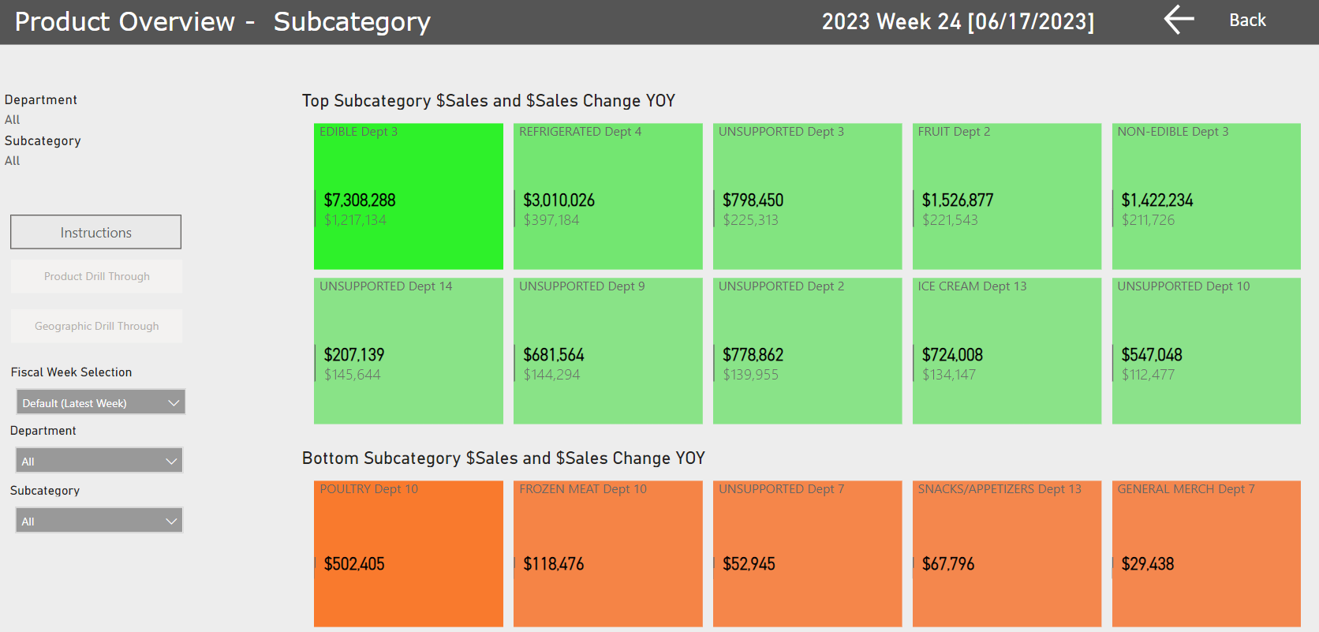
Selecting a tile allows you to select “Geography Drill Through.”
This brings you to the geography overview of the selected class.
For further question or troubleshooting, email support@1010data.com
Product Overview

Slide 15
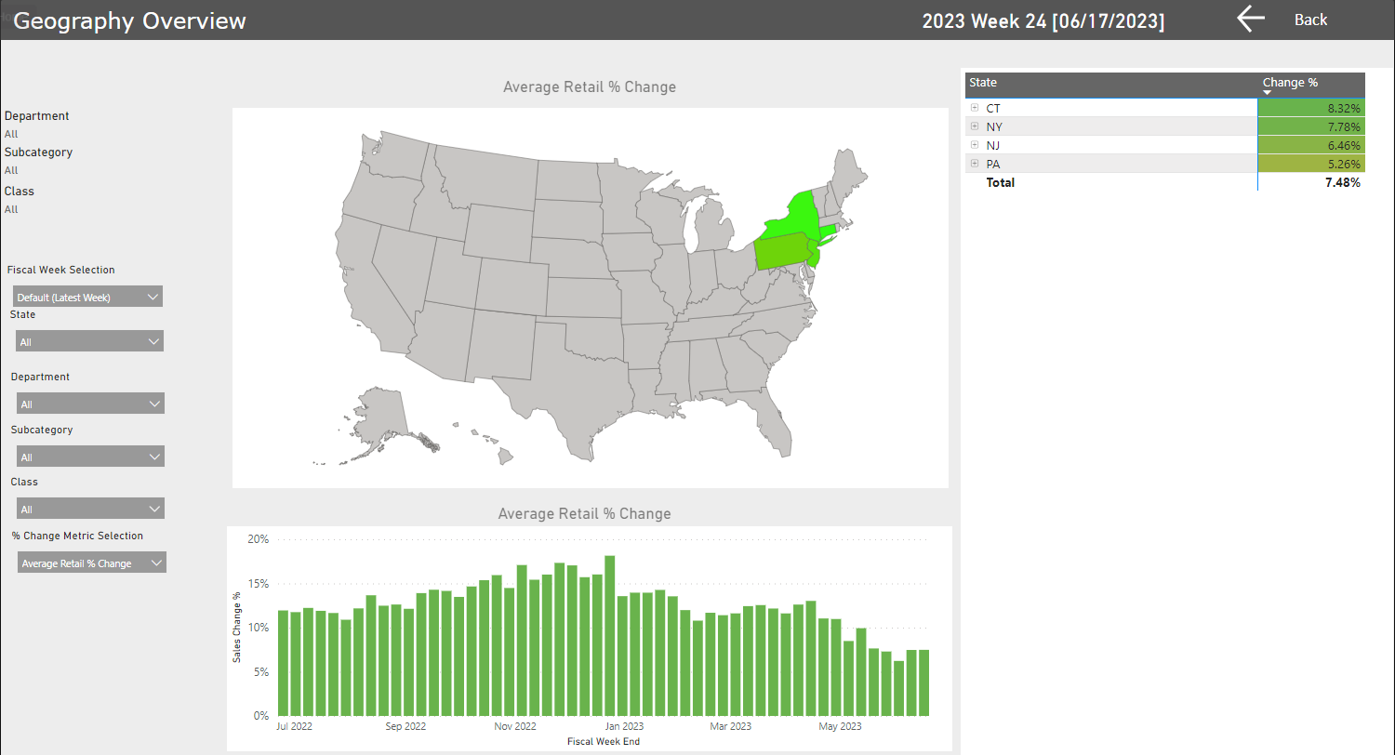
For further question or troubleshooting, email support@1010data.com
Geography Subsection
Selecting the (i) icon for the Geography Subsection will redirect the user to the Geography Overview and allow analysis by product line and state

Slide 16
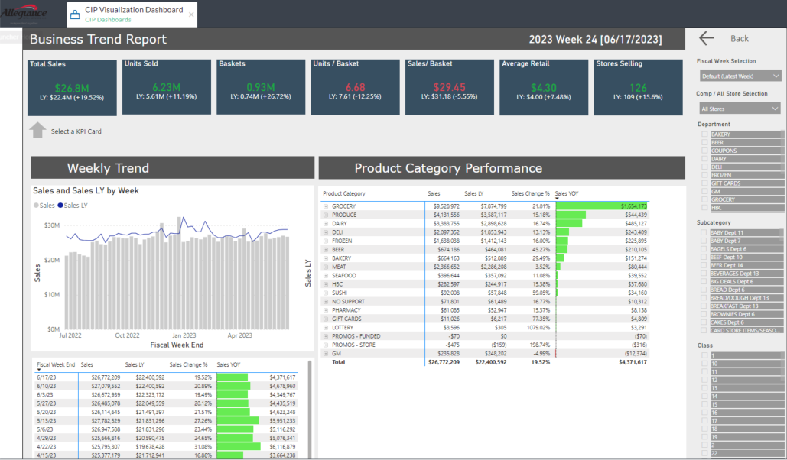
Metric cards listed above visuals, filter selections right pane.
Change metric selection by clicking on one of the cards.
For further question or troubleshooting, email support@1010data.com
Business Trend Report

Slide 17
Questions?
Please reach out to support@1010data.com

